Slide 1

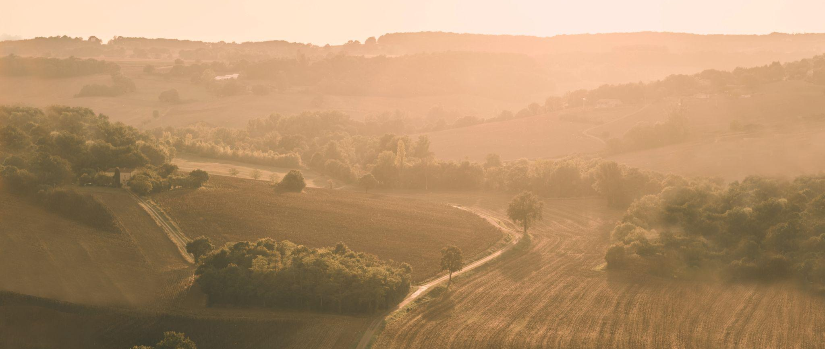
2026

Slide 2
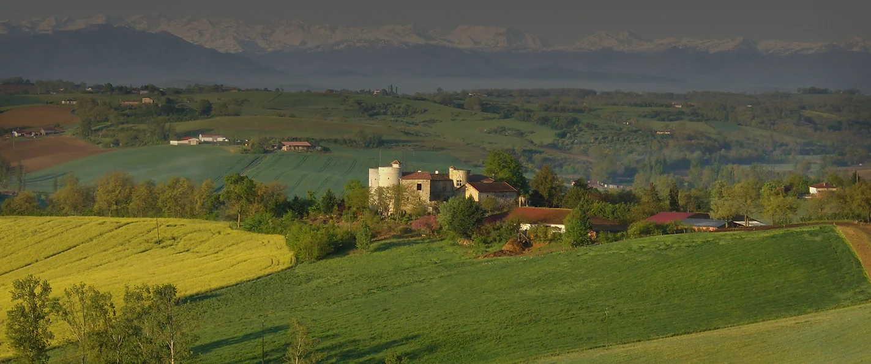
ABOUT GASCONY
Beautiful, unspoilt, and welcoming part of Southwest France
Our rental area covers the ancient Duchy of Gascony, close to the Pyrenees Mountains and stretching all the way between the cities of Bordeaux and Toulouse. In medieval times Gascony belonged to England. Today, with its slow pace, traditional farming community and wonderful quality of life, Gascony is similar to Tuscany.
Great climate, proper countryside, wonderful local markets
Gascony enjoys a warm, sunny climate with early spring typically leading into a long summer and famously warm autumns. In winter there is excellent, uncrowded skiing in the Pyrenees. This beautiful countryside has very little traffic and minimal pollution, providing endless scope for expeditions from the relaxing to the energetic. Perfect for lounging by the pool or exploring ancient villages and local markets.

Slide 3
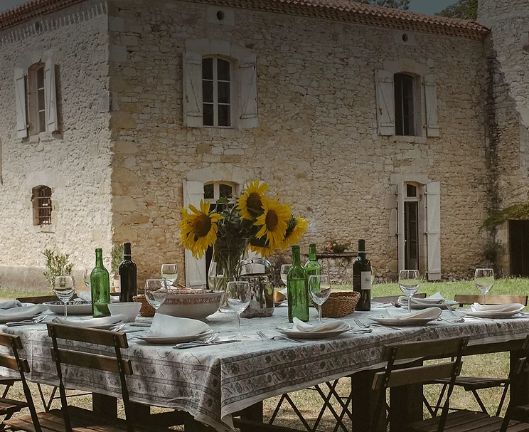
Perfect for families and groups of friends
A country house holiday is the perfect way to spend a relaxing time with family and groups of friends. Along with the numerous activities available at each property, there is something for everyone here in Gascony. Biking, tennis, golf, horse riding, air-ballooning, mountain trekking, the list is endless. Gascon holidays can be enjoyed by everyone at their own pace.
Delicious food and wine, fascinating history and architecture
If you enjoy locally sourced, really tasty French food and wine then come to Gascony! This region is renowned for its local delicacies and excellent country wines and Armagnacs. There are hundreds of medieval ‘Bastide’ villages, iconic ‘Pigeonniers’ and historic buildings, many associated with the ancient pilgrim routes to Santiago de Compostela in Spain.

Slide 4
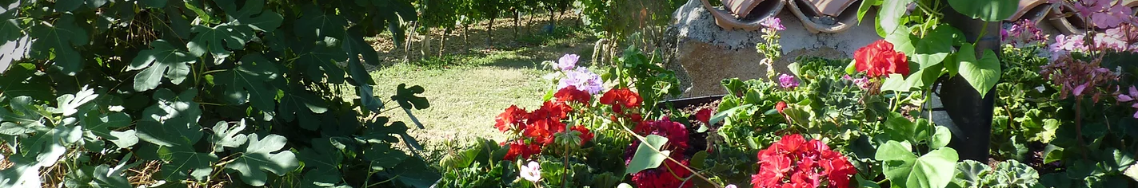
Our properties
Simply Gascony offers a wide range of special country properties all within 100 kms of Auch, the capital of the département of Le Gers. Each of these really appealing cottages, farmhouses, country houses and Châteaux has its own character and charm. Individual properties sleep from 2 to 24 adults. The walled medieval ‘Village’ sleeps up to 50 adults in 8 individual properties – perfect for that special celebration.
Our services
We at Simply Gascony know and love this area and have been managing holiday rentals for decades. We make it simple for our guests to find their perfect holiday house in Gascony. Each property has a local housekeeper who will provide a warm welcome to guests and is their main point of contact. We can provide many helpful services, including pre-arrival shopping so that our guests’ kitchens are well stocked on arrival.
ABOUT SIMPLY GASCONY

Slide 5
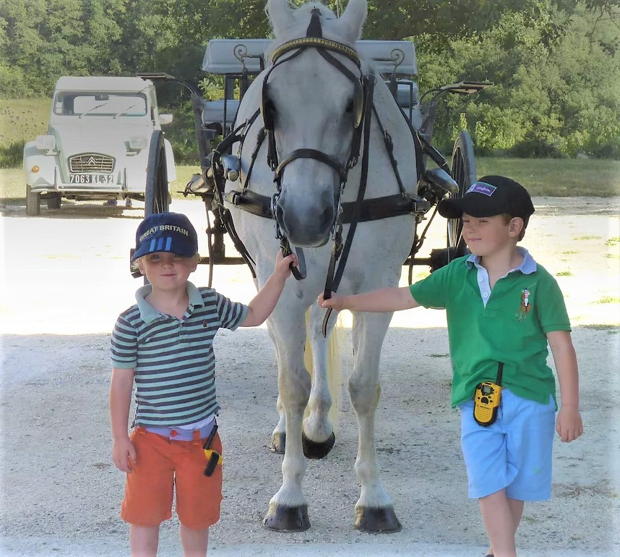
Customised personal service
We pride ourselves in being able to go far beyond the typical holiday rental agency. By working closely with each housekeeper and our Working Partners, we provide our guests with a customised personal service so that they will have a truly relaxing and unforgettable holiday in this beautiful part of Southwest France.
Our working partners
Our ‘Working Partners’ are local businesses known to us that provide our guests with a wonderful variety of add on facilities and services. The commercial arrangements are made directly between each guest and the service providers. This means our guests receive the services they want tailor made to fit their holiday plans.

Slide 6
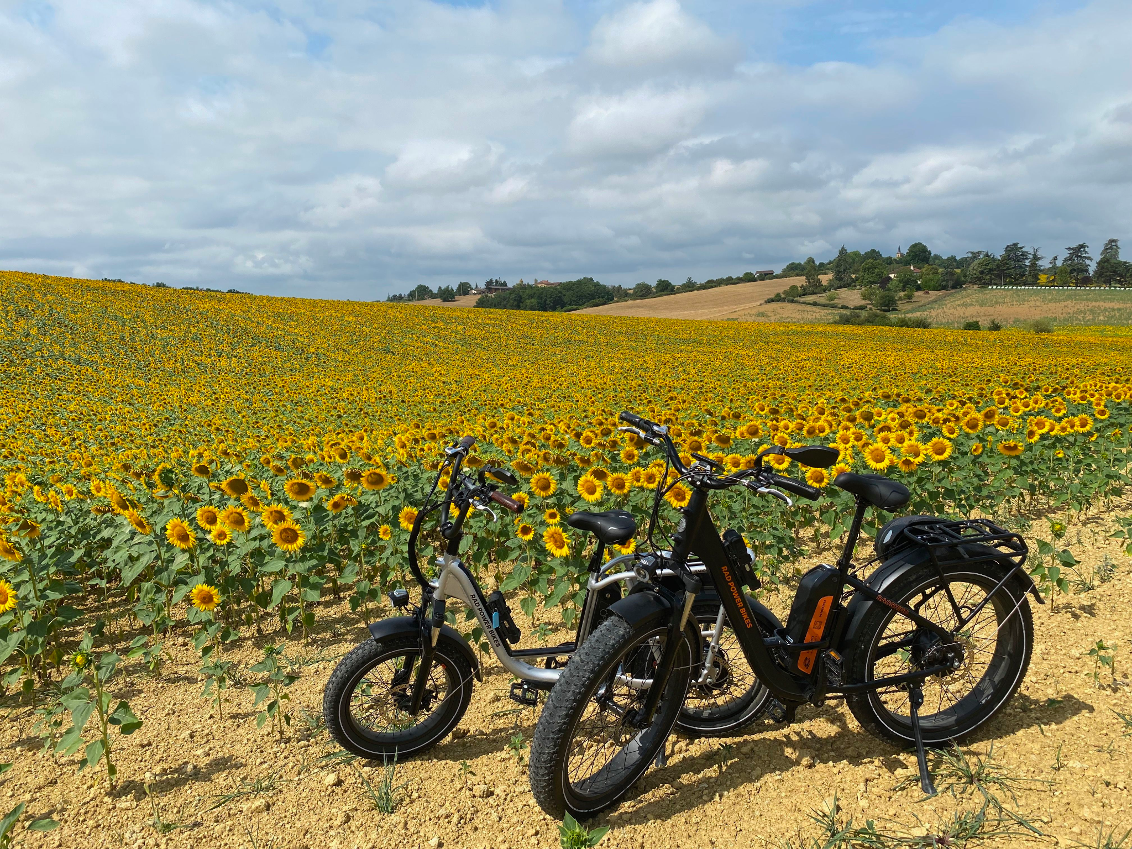
Electric bike hire at the property
Gascony is a perfect biking country. You will find a deeply rural and very attractive undulating countryside with very little traffic, and lots of mediaeval ‘bastide’ villages and market towns. e-Velo Gers provide our guests with high quality electric bikes to suit each rider, delivered to the rental property and ready to use when guests arrive.
Group wine tasting tours by bike
Gascogne Bike Hire & Tours offers guests staying in SG rental properties a variety of planned Self-Guided Biking Tours, wine-tasting, ‘bastide’ villages, ancient châteaux and a gastronomy tour, with a delicious picnic as an optional extra. Gascogne Bike Hire can also recommend good biking circuits near the rental property.
OUR Working Partners

Slide 7
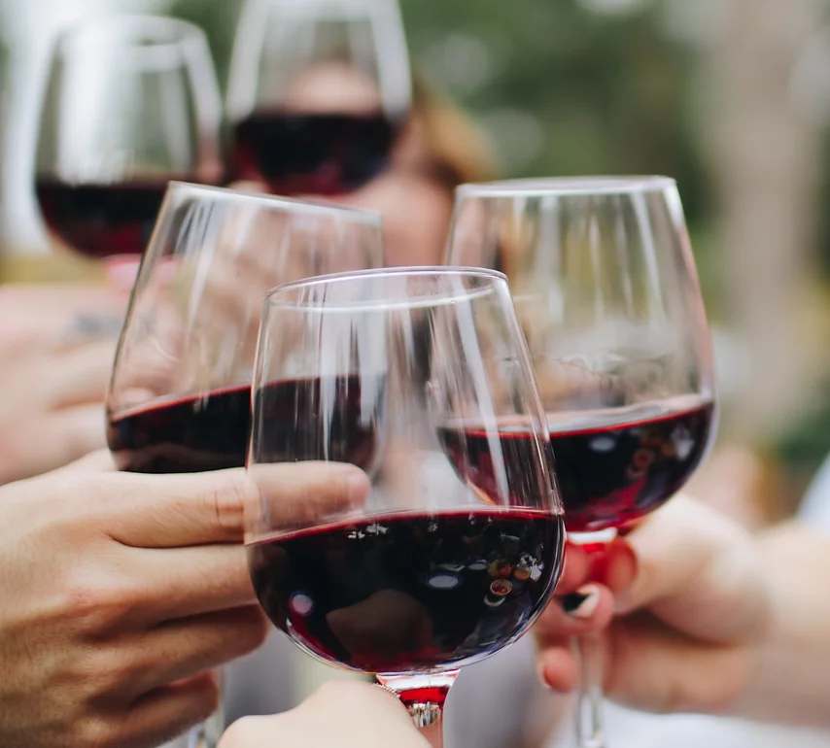
Local Wine tastings
Gascon wines are ‘authentic country wines’, many made by small independent producers using local grape varieties. De la Terre au Verre (‘From the Earth to the Glass’) will host wine tastings in Lectoure or recommend wine properties near our guests' houses for a tasting visit. Le Cho Truck will bring a vintage Citroen van full of wine samples for guests to taste at their holiday home.
Cookery workshops at the property
Gascony is renowned for its varied local cuisine, and Atelier Cuisine Fourcès are real experts in this field. Laura will organise a cookery workshop in her own kitchen or at your holiday home. She will also lead our guests to a bustling local market to buy local produce before heading back to prepare and cook a meal together. Guests will learn local recipes and discover the traditions and history of Gascon food.

Slide 8
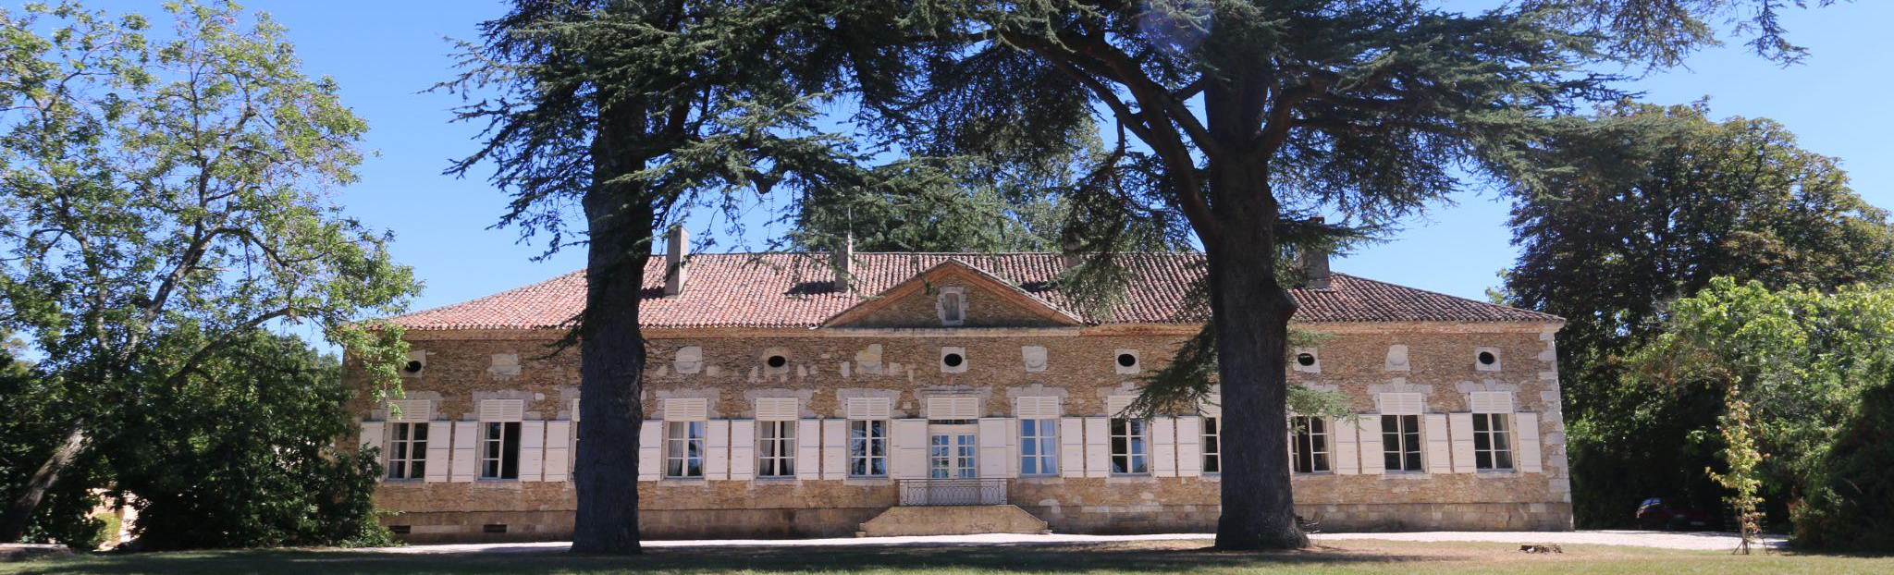
SIMPLY GASCONY - SIMPLY ENJOY!
Authors
Marie-Aude Koné
Rebecca Dunipace
Editor
Robin Dunipace
ROBIN@SIMPLY-GASCONY.CO.UK
TEL: +44 7970 69 88 67
Copyright © Simply Gascony 2022.

